Slide 1

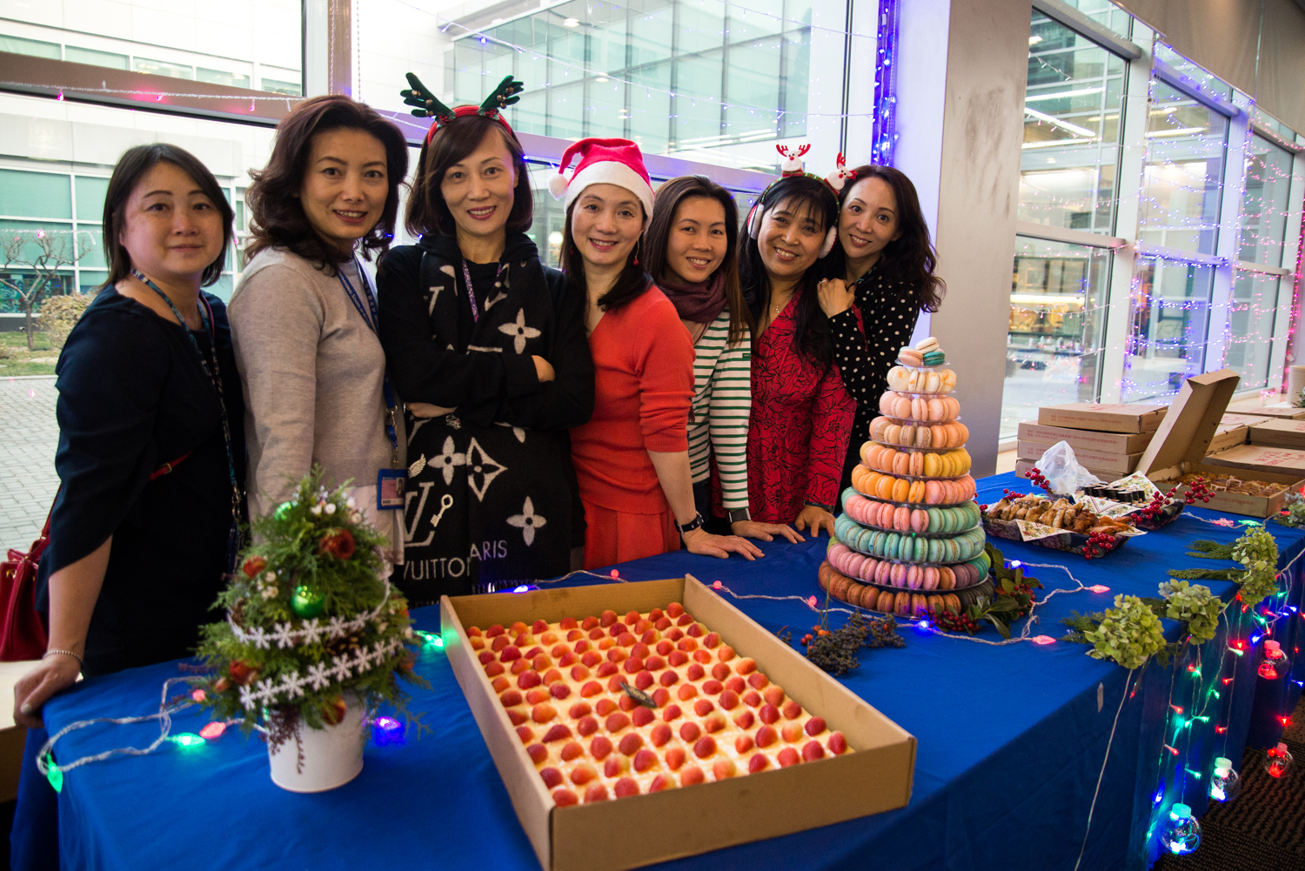
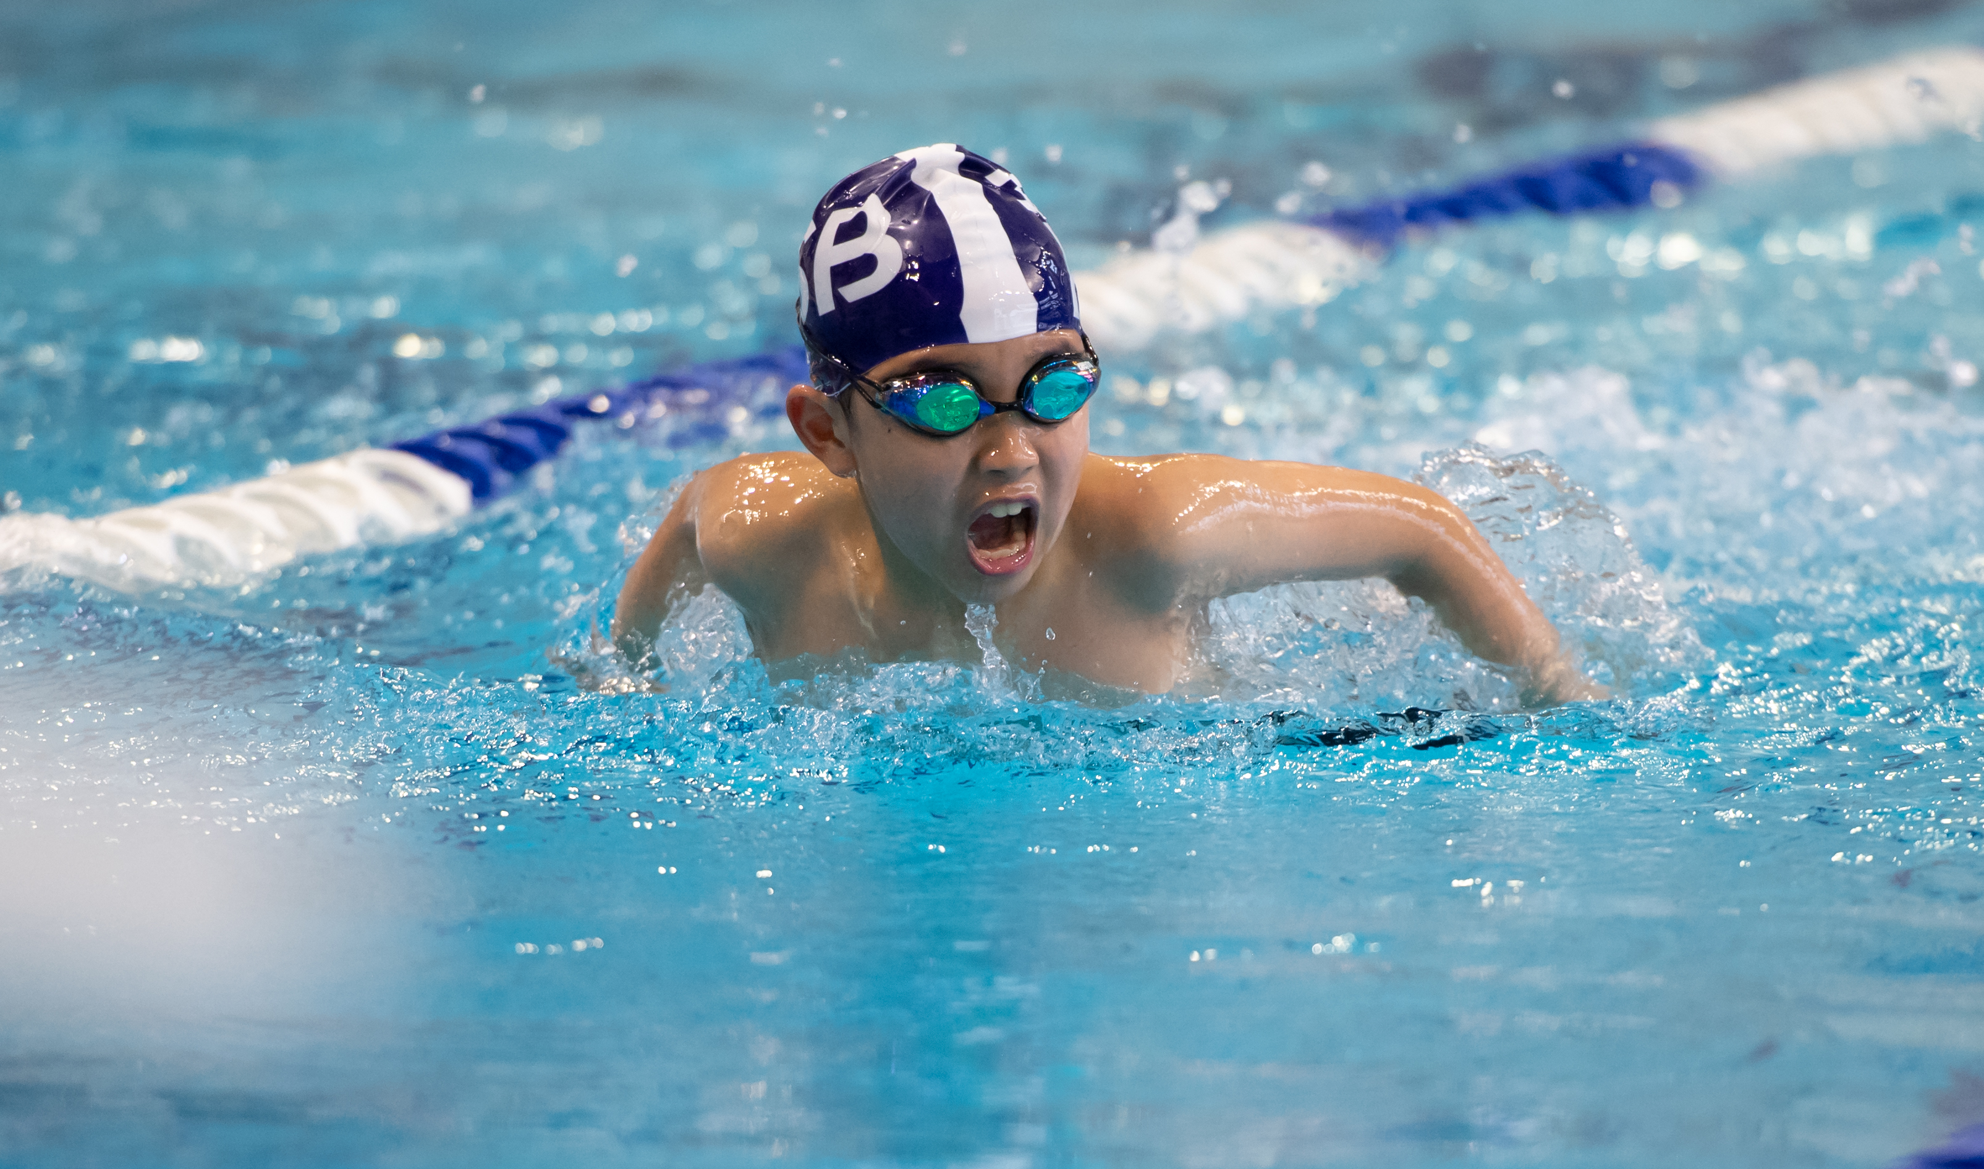
ISB SWIMMING ACADEMY
INFORMATION EVENING
2021-22

Slide 2
New This Year – Season Focuses for Meets
UES (Grade 3-5) – September -> October
HS (Grade 9-12) – End of October -> End January
MS (Grade 6-8) – February -> April
LES (Grade K-2) – May -> June
Objectives:
Development pathway
More internal meet opportunities

Slide 3
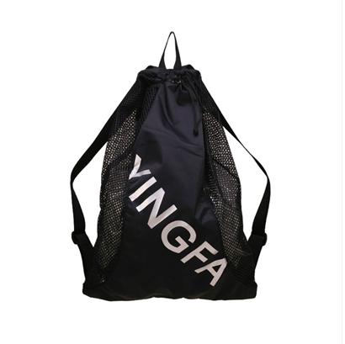
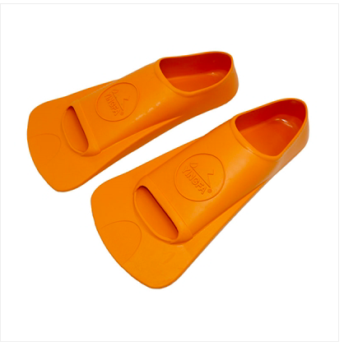
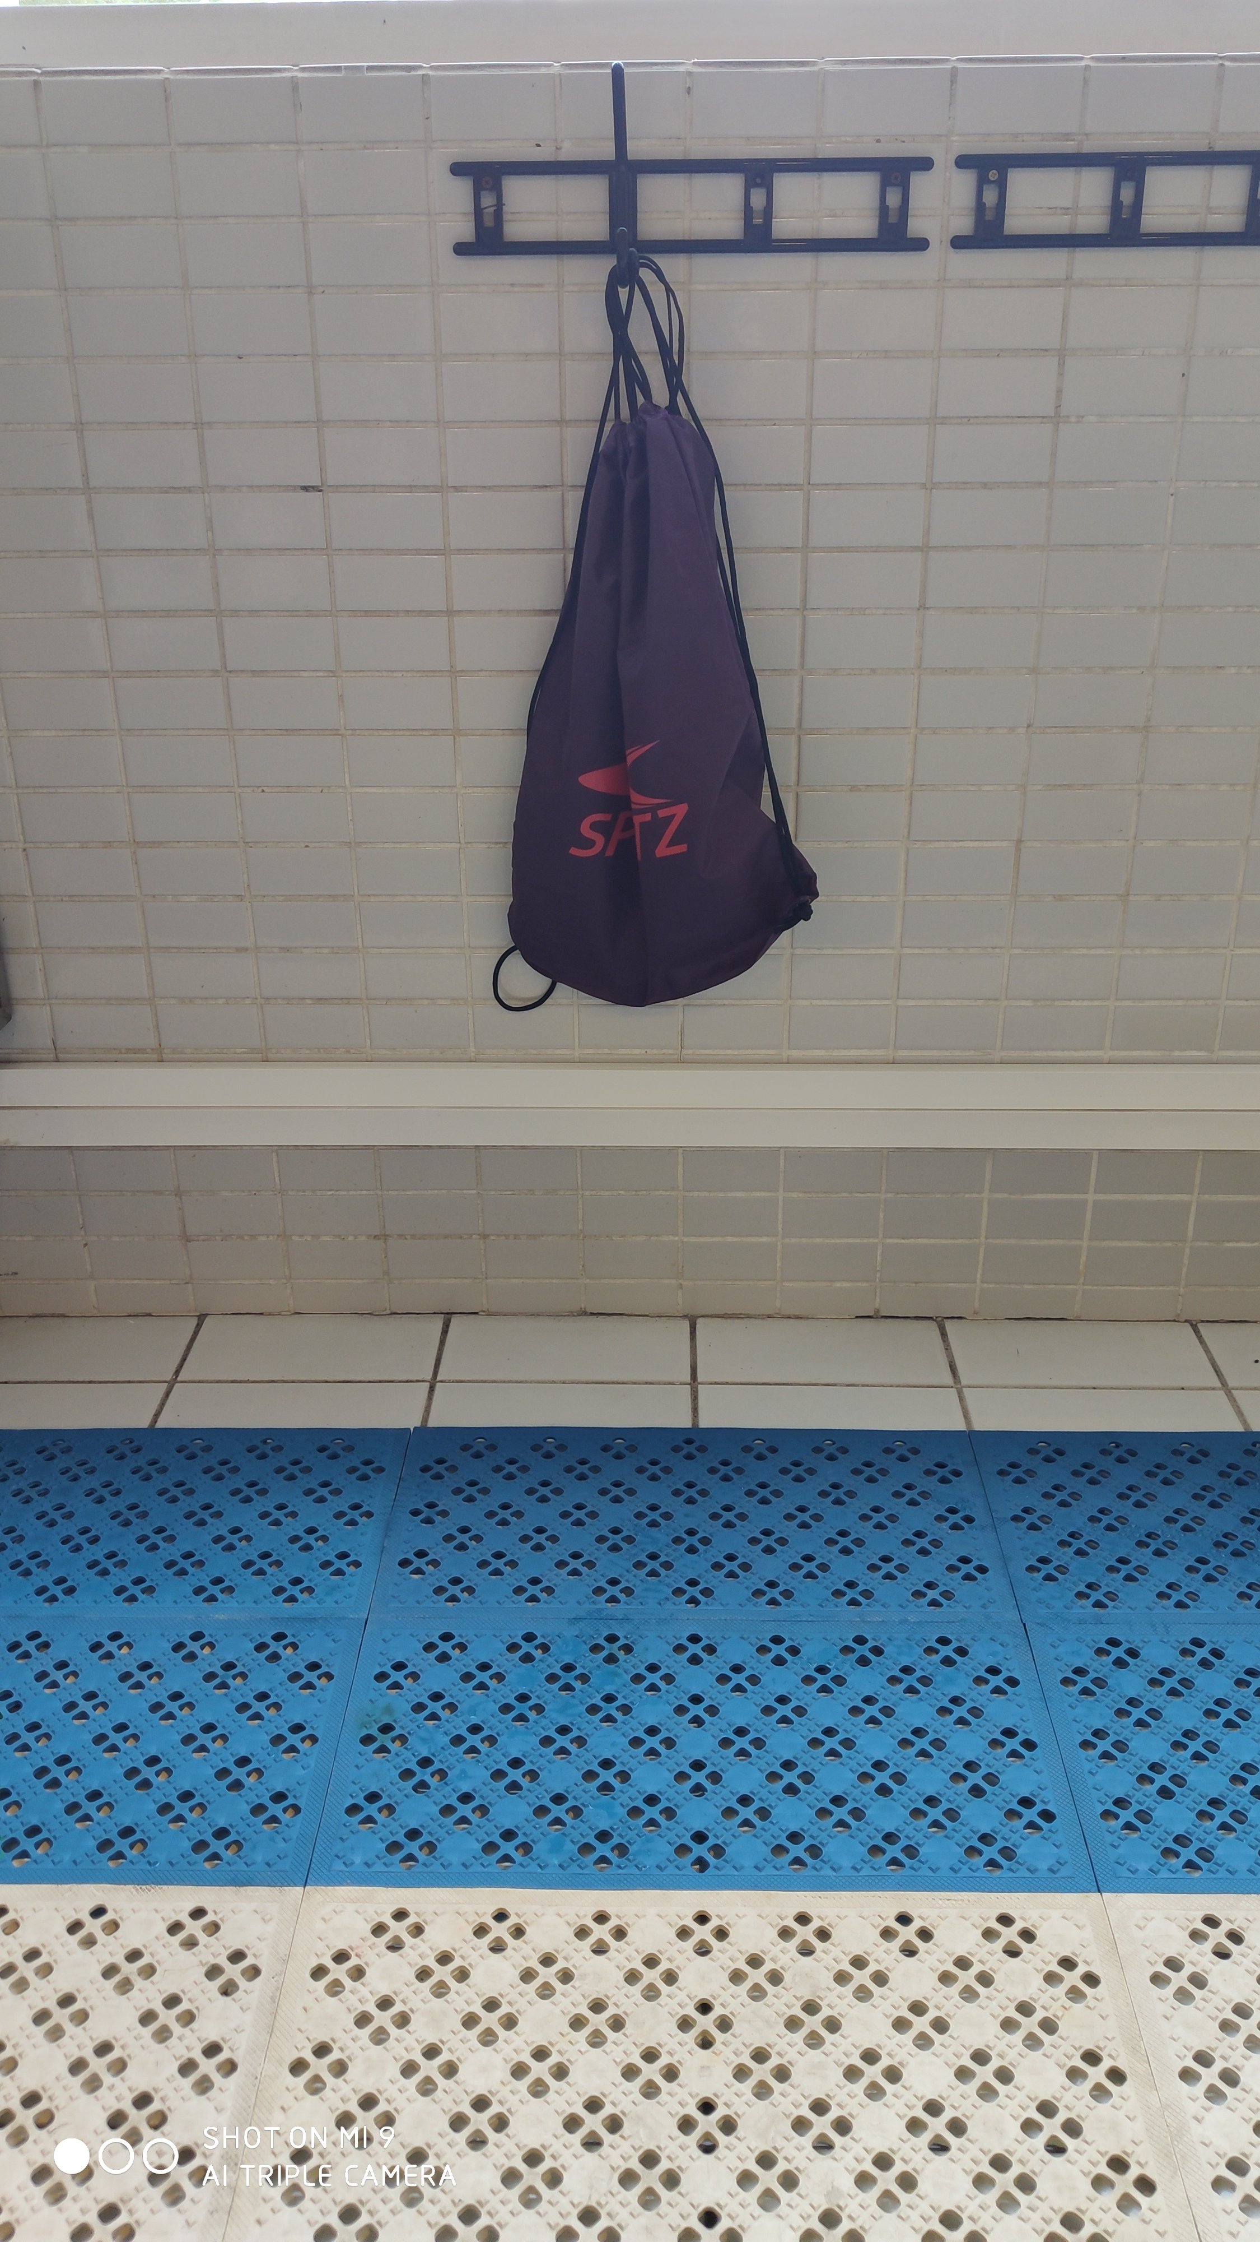
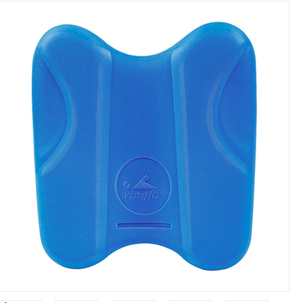
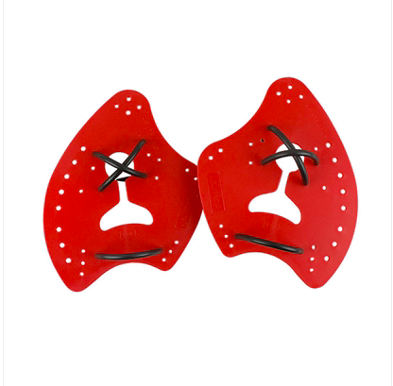

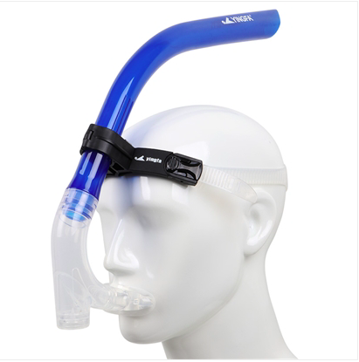
New This Year
Equipment for all swimmers.

Slide 4
Swim Academy Numbers
September 2021
+- 175 Swimmers
Exactly the same as pre-covid 2019-20 numbers.

Slide 5
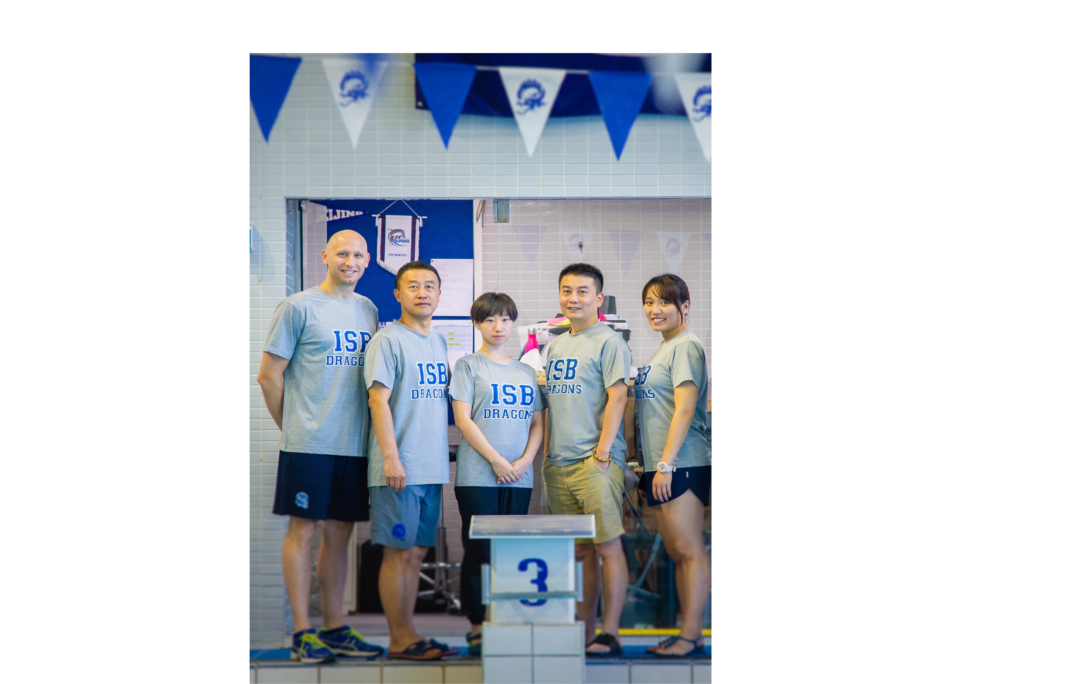
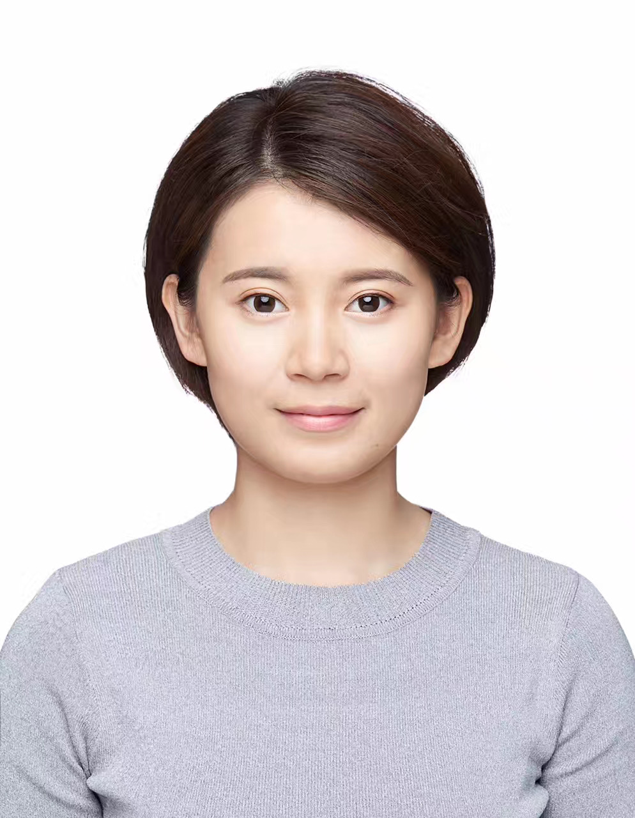
Aquatics Team

Slide 6
Welcome – Mona Tao
I was trained in the swimming team in YMCA when I was lived in Freeport Bahamas, and I have 7 years experiences in swimming coaching and am professional certificates holder issued by authorities in China and the U.K. I am good at staged class designing and help students to improve their swimming skills step-by-step.
I really enjoy working with children and I do have good communication skills.
It’s a great honor for me to join the ISB team, and we will work hard together in the following time.

Slide 7
Our Roles
Joe Zheng – Baby Dragons, Little Dragons Silver & Gold
Arthur Wang – ES Blue Squad
Ariel Wu – ES Bronze Squad, Upper-Level Squads and Varsity Girls Head Coach.
Mona – Little Dragons Bronze, MS Blue / Bronze Squad Coach
Jenny Deng – TA / Office Assistant
Nic Wilson – Aquatics Director, UNI / Varsity Boys Squad Coach

Slide 8
Squad Coaches
Coach | LDB | LBS | LDG | ESB | EBR | MSB | MBR | SS | GS | UNI | HSP
Ariel |  |  |  |  | * |  |  | * | * | * | *
Arthur |  |  |  | *
Joe |  | * | *
Mona | * |  |  |  |  | * | *
Nic *Support |  |  |  |  |  |  |  | * | * | * | *

Slide 9
Communications
Nic Wilson – Aquatics Director – nwilson@isb.bj.edu.cn
General enquiries should be sent to jdeng@isb.bj.edu.cn
Squad or Swimmer Related Queries – Applicable Coaches
Joe Zheng – wgzheng@isb.bj.edu.cn
Arthur Wang - awang@isb.bj.edu.cn
Mona Tao – mtao@isb.bj.edu.cn
Ariel Wu – awu@isb.bj.edu.cn
WECHAT – This is not our official communication channel.

Slide 10
Activities Department Team Support
Simon Parker – Activities Director - sparker@isb.bj.edu.cn
Randen Morisako – Strength and Conditioning – rmorisako@isb.bj.edu.cn

Slide 11
Volunteer Committee Team
Volunteer Overseer – Jenny Deng
Volunteer Co-Ordinator – Camilla
Team Manager / Meet Manager Tech Support – Connie supported by her team.
Team Photographer’s – Frances & Xiaolong, supported by a team of parents.
Starter Team – Eric, supported by his team.

Slide 12
Positions Needed 2021-22
Photography Team – Please enquire to Coach Nic if you are interested.
Systems Team – Training required. Please connect with Connie or Coach Nic for more information.
Starter Team - Training required. Please connect with Eric or Coach Nic for more information.

Slide 13
Want to get more involved?
Systems Training @ Swimming Pool
Wednesday 13th October – 10:00 – 11:25am
Starter Training @ Swimming Pool
Wednesday 13th October – 12:20 – 1:00pm
*Please contact Coach Nic nwilson@isb.bj.edu.cn if you would like to sign up.

Slide 14
Desks Outside The Venue
General Enquiry Desk – Handbook Entry forms and general enquires at this desk
Equipment samples on display for swim finz sizing.

Slide 15
Equipment Size Checking
Rocket Science have a guide. They will except re-call or changes in sizes if incorrect.
Jenny will have a desk oustide the swimming pool next week - Monday, Tuesday, Wednesday, Thursday 3:30pm until 4:00pm. Swimmers can try on finz sizes then.

Slide 16
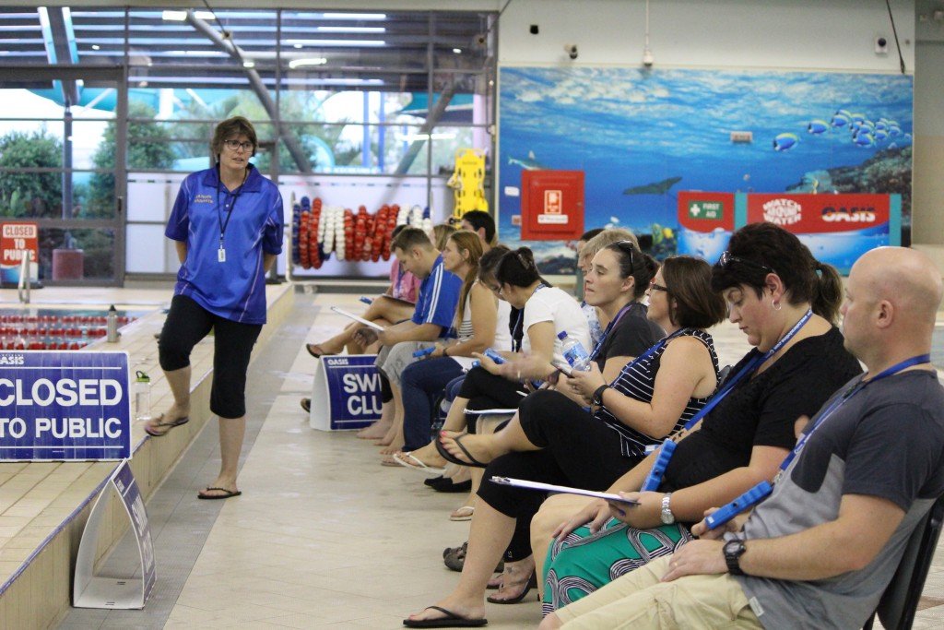
Parent Volunteering
2 meets a year per child
Sign-up Online through Team Unify

Slide 17
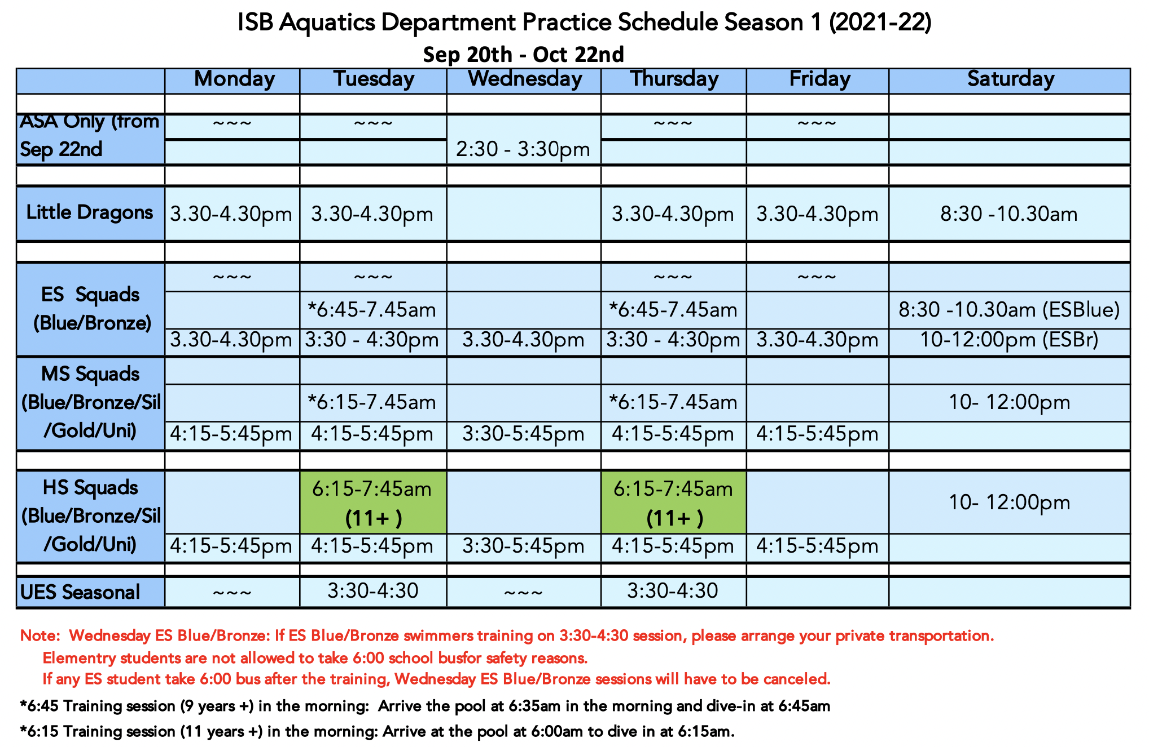
Academy Session 1

Slide 18
Schedule Reminders
3:35pm - ES swimmers should be diving in
4:15pm - MS / HS swimmers should be on deck for a stretch and limber.
Wednesday Practice times
3:30 – 4:30 – ES Blue and Bronze (Private Transport)
3:30 – 5:45 – Early session start for MS / HS

Slide 19
Tech Lane
Every Wednesday 3:30 – 4:30pm
Rotation of tech lane throughout the year
HS – Next week until October 22nd
MS – From October 22 – End January
ES from January – End April
HS, MS, ES rotation every week until the year end.

Slide 20
ISB’s Long Term Athletic Development Model
University Squad – NCAA BEYOND
Silver Squad 2 practices
TRAIN TO COMPETE
Little Dragons – 2 practices
FUNDAMENTALS
Bronze Squad 2 practices LEARNING TO TRAIN
Blue Squad – 2 Practices
LEARNING TO PRACTICE SKILLS
Gold Squad 2 practices TRAIN TO WIN
IM Focused
Technique

Slide 21
How Many Practices Should my child be doing?
Rough Guide – Age divided by 2 minus 1
7-8 – 3 Practices a week
9-10 – 4 practices a week
11-12 – 5 practices a week
13-14 – 6 practices a week
15 & O – 7 – 8 practices a week
Multi Sport Athletes are recommended to stick to our minimum attendance due to other sport commitments.
HS Pre-Season Athletes have more flex options depending on academics and other season sports. TBD

Slide 22
Attendance
Academy Swimmers – 2 practices a week for all squads this season.
High school season swimmers – 3 practices a week.
What if swimmers don’t attend?
There will be 2 Gentle Reminders.
3rd offence will mean swimmers miss either a swim meet or a relay position in the A or B relay team at the next meet.
In season attendance may affect being selected for certain events.

Slide 23
How will we take attendance this year?
ES will be ticked off on a squad roster. Weekly messages on your child's attendance will be mailed to everyone.
MS / HS will sign in with a QR code at the front entrance to the pool. They can sign in with their own device, or with the Ipad provided.
Please indicate your attendance in the applicable section in the handbook.
Permanent changes of schedule - please e-mail jdeng@isb.bj.edu.cn to change this on the system.

Slide 24
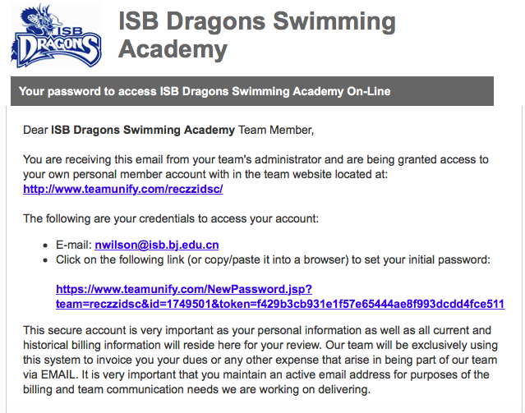
Steps To Follow When in the Team
STEP 1 - Team Unify Log-in. If you do not receive this e-mail before the weekend, please contact Jenny Deng on Monday next week.

Slide 25
Steps to Follow When in the Team
STEP 2 – Fill in the forms within the Handbook. Helpdesk outside has copies, or they are available on the dragon's gate under Aquatics.

Slide 26
Steps to Follow When in the Team
STEP 3 – Pay applicable fees at the Box office 2nd floor in the business office.
Younger ES parents can ask TA’s in their home room to support the delivery of money to box office.
Send only money to the box office in an envelope with First Name, Last Name, Squad and Swimming academy fees written onto it.
STEP 4 – Deliver handbook forms (Pg 2-5) and payment slip to the swim office before Thursday 30th September Deadline. Please do not hand in money to the swim office.

Slide 27
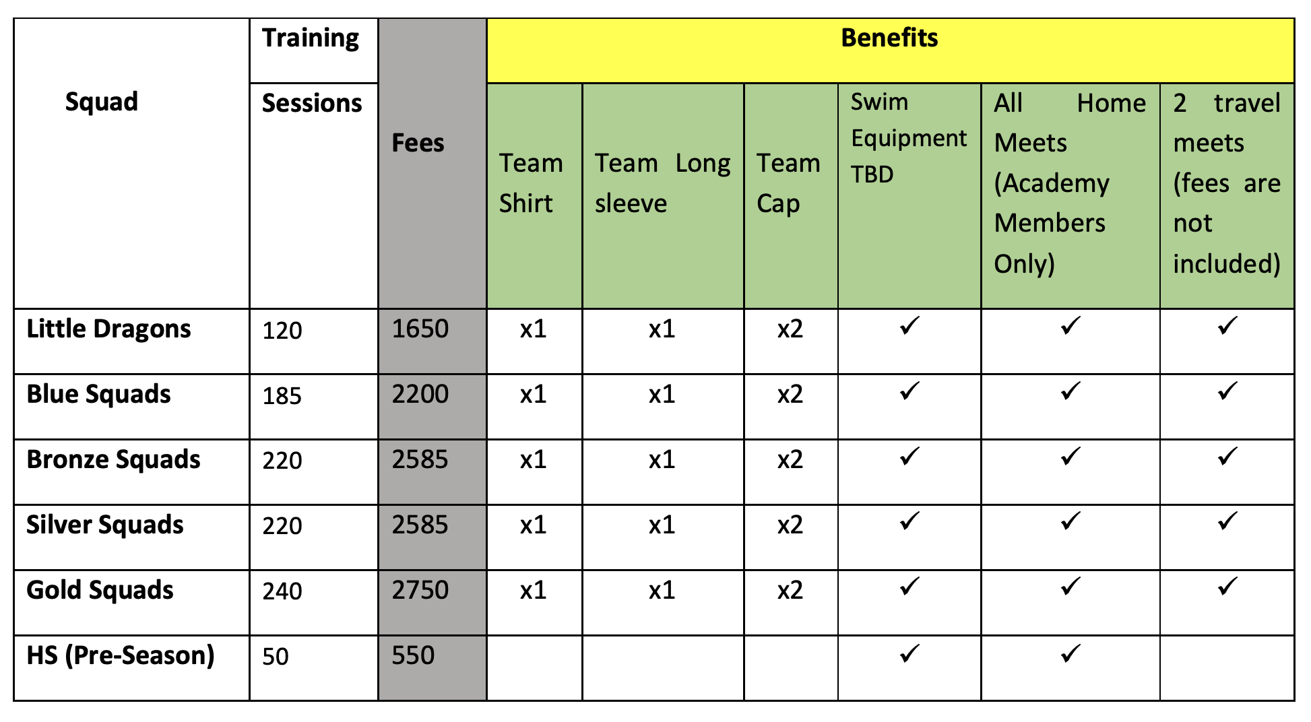
Fee Structures

Slide 28
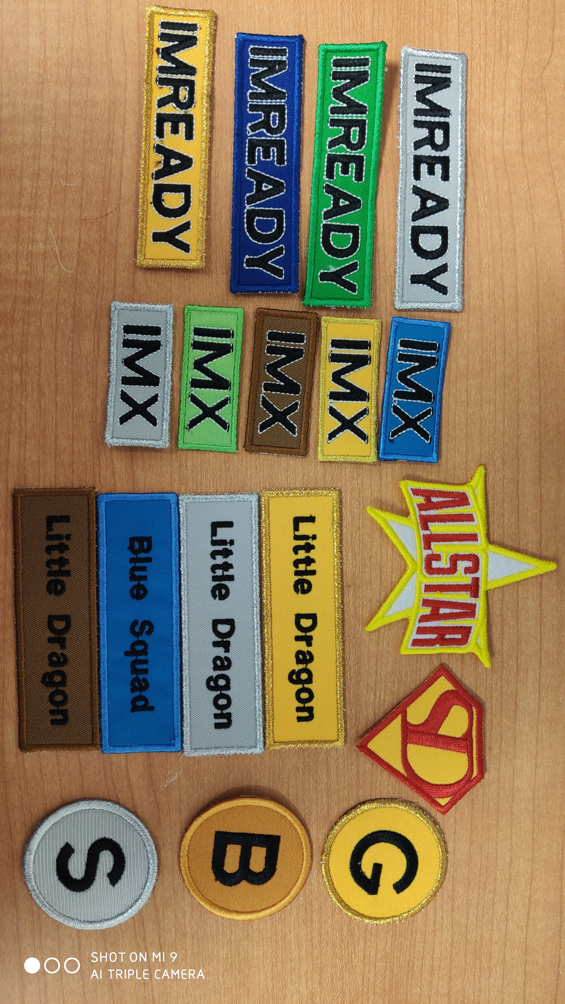
What else do the fees cover?
ISB Award Scheme
Winter Party & End Of Year Party
Access to the Team Unify Website
End of year tags
New – Equipment

Slide 29
GUIDE TO FOLLOW ON ROCKET SCIENCE PORTAL

Slide 30
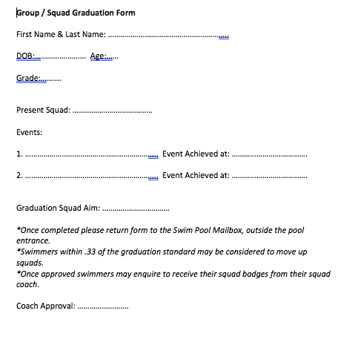
Award Scheme - Graduation Badges
How to receive Graduation Badges
Find this form on our documents page – Team Unify

Slide 31
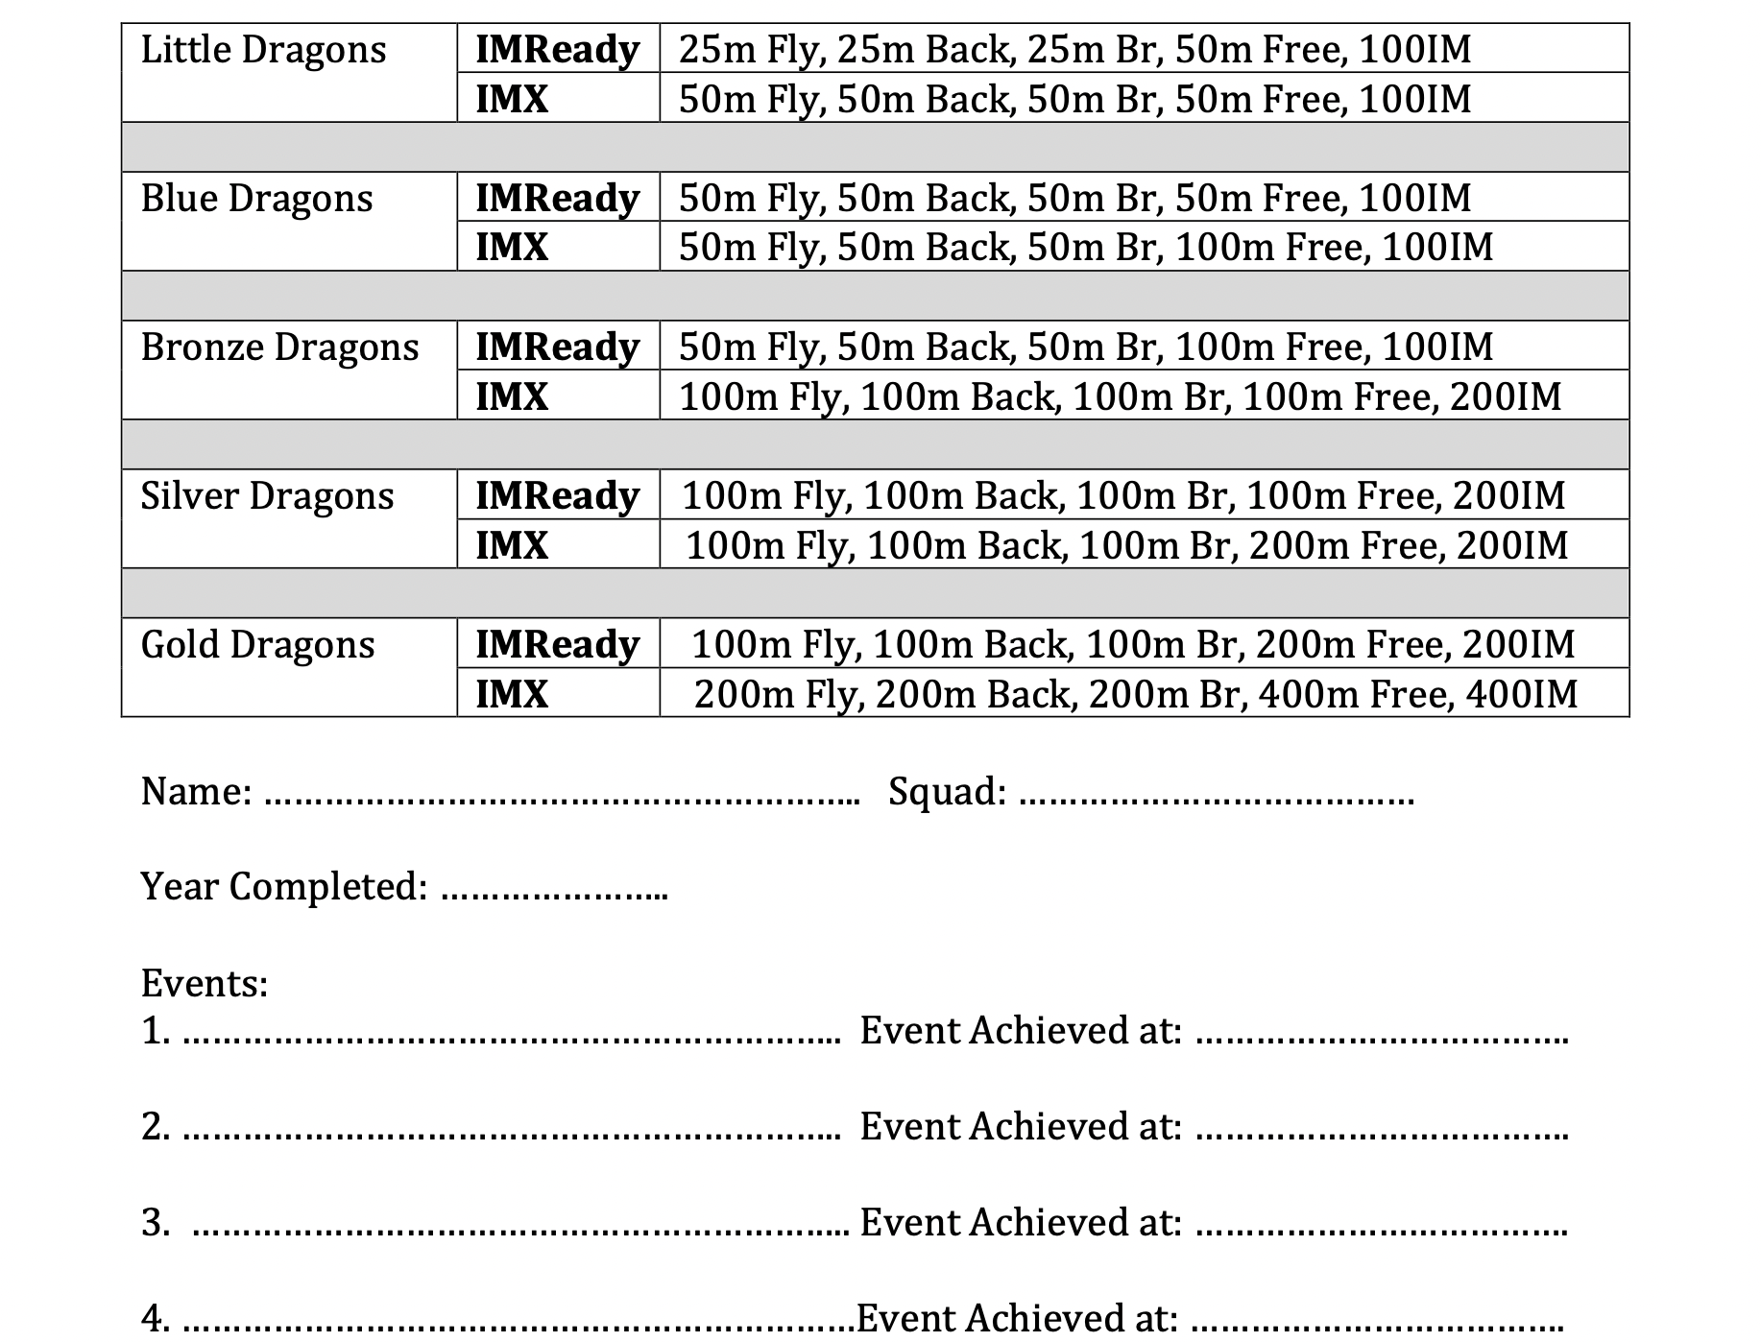
Award Scheme – IMX and IM Ready

Slide 32
Team Unify
Sign Up Via Team Unify E-mail
Add as much Information on your profile – photo.
View Help Tutorials
Seek our Help – jdeng@isb.bj.edu.cn
Sign-up for volunteering at meets – Tutorials will help.
Viewing swimmer information.
On Deck Parent App. RECZZIDSC

Slide 33
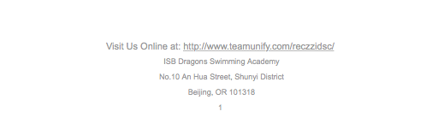
Logging Into Team Unify Site
Find the URL at the bottom of our e-mails.
Save and Bookmark the page on your browser.

Slide 34
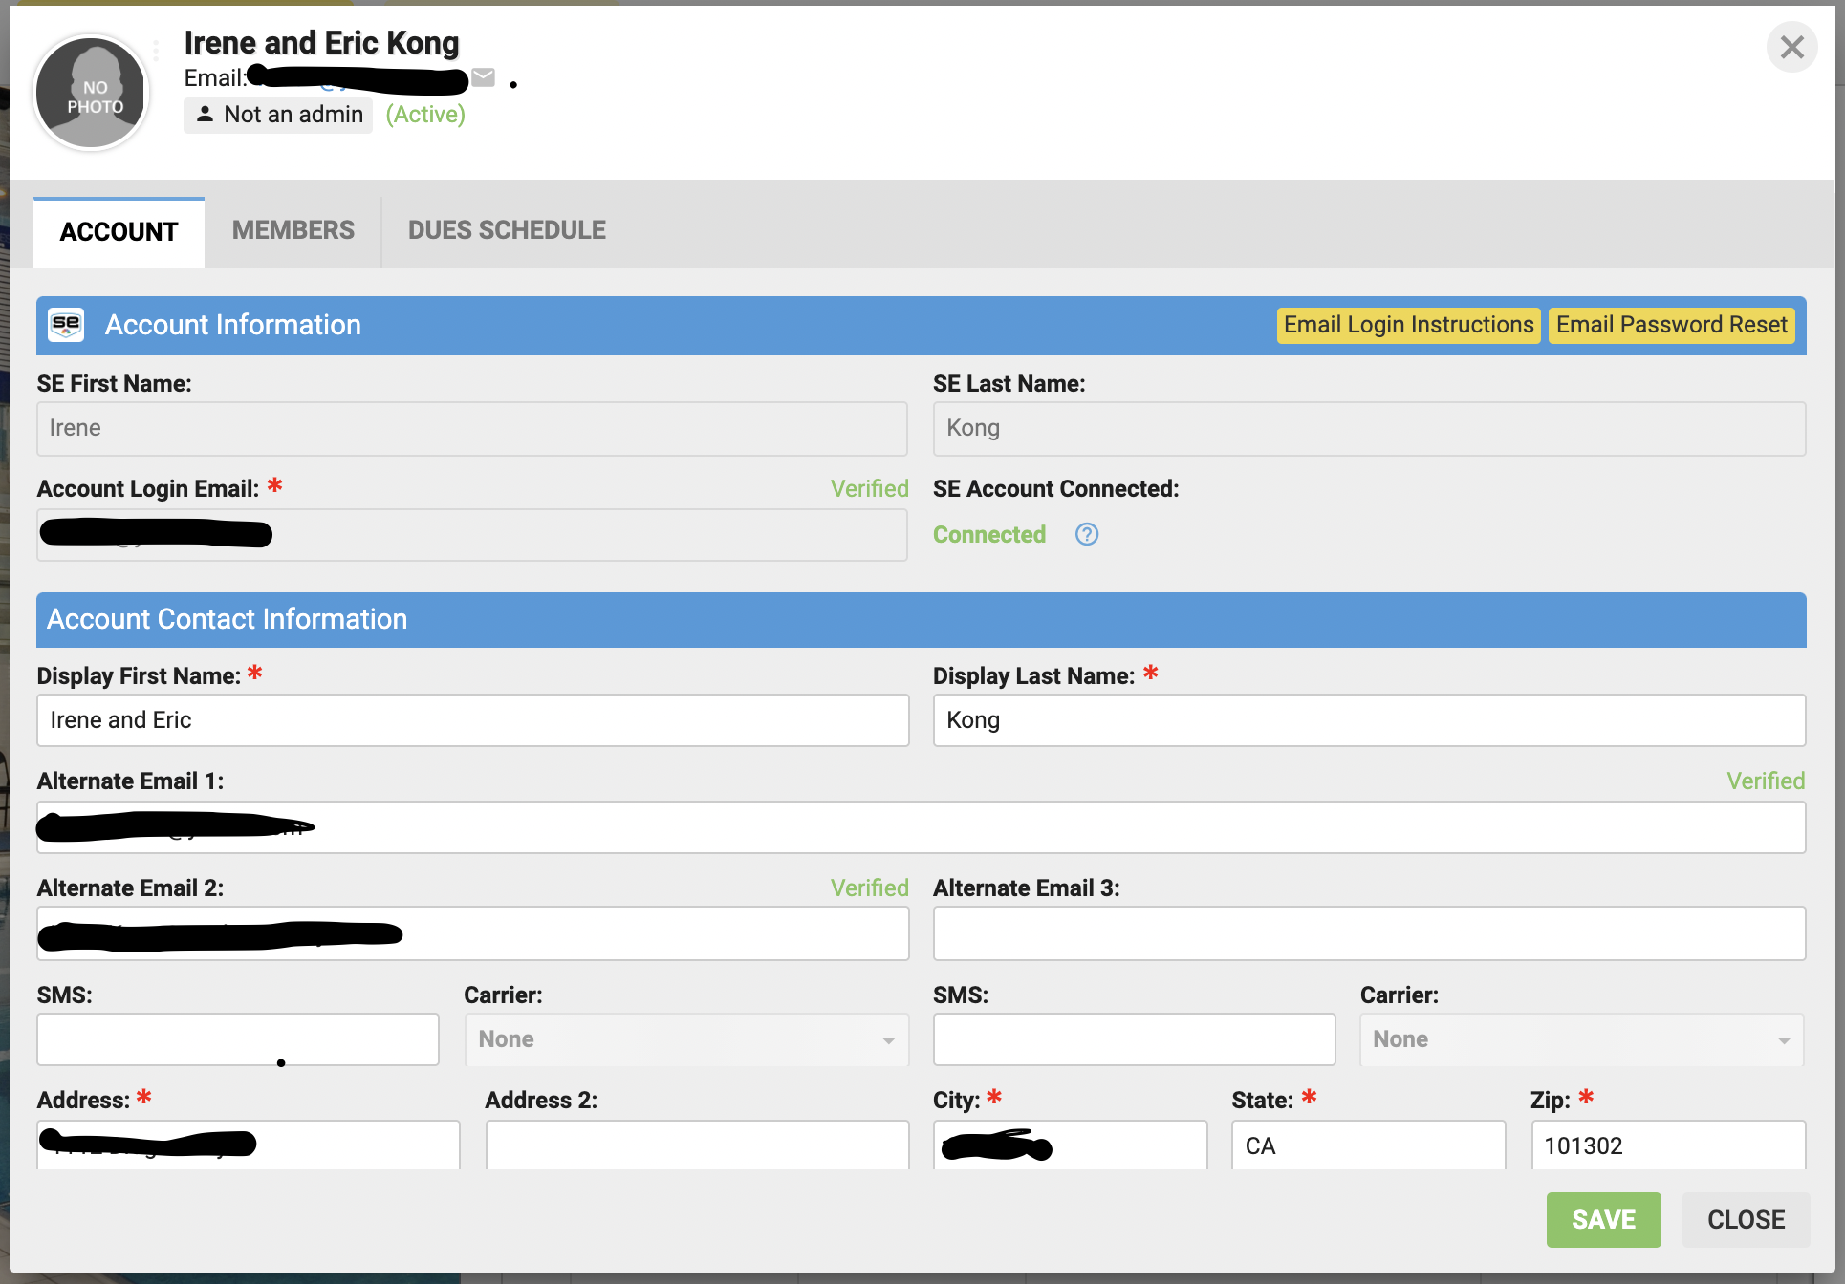
My Account

Slide 35
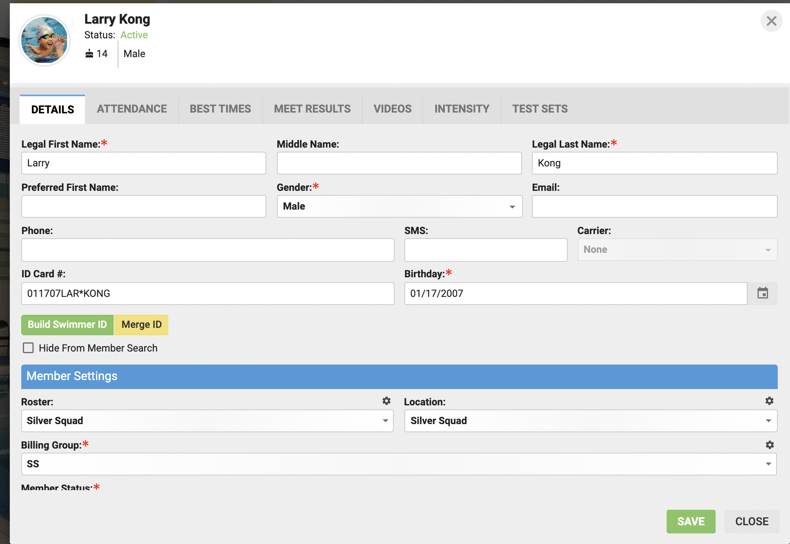
Member Profile

Slide 36
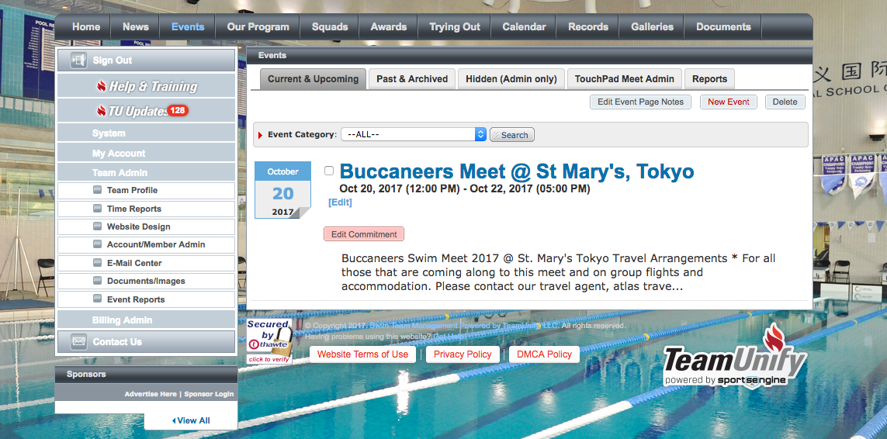
Signing Up For Meets

Slide 37
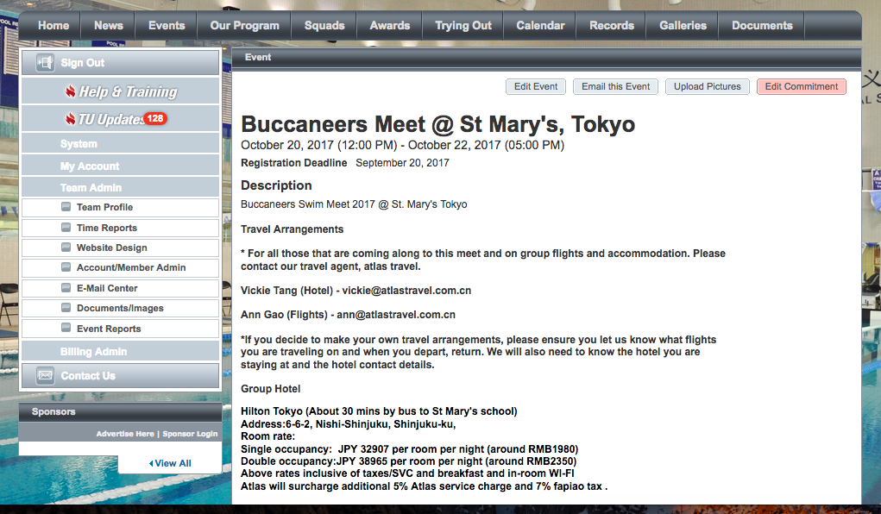
Signing Up For Meets

Slide 38
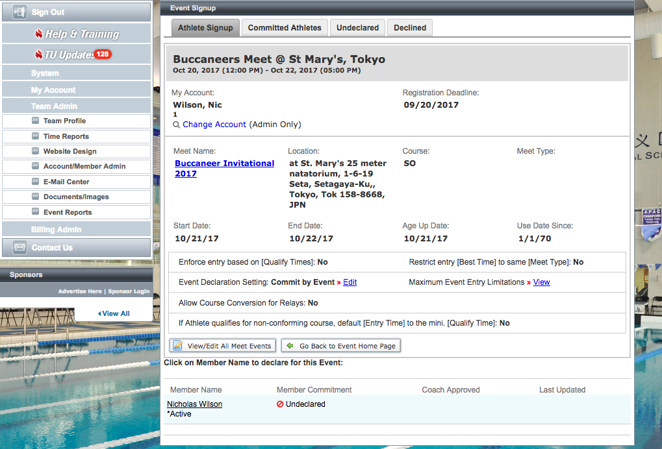
Signing Up For Meets

Slide 39
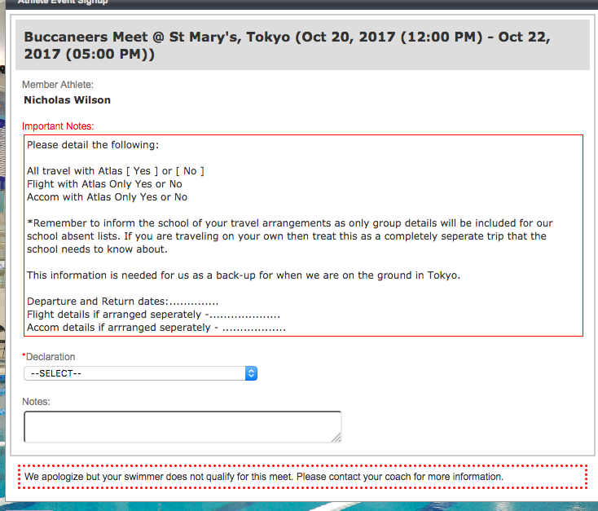
Signing Up For Meets

Slide 40
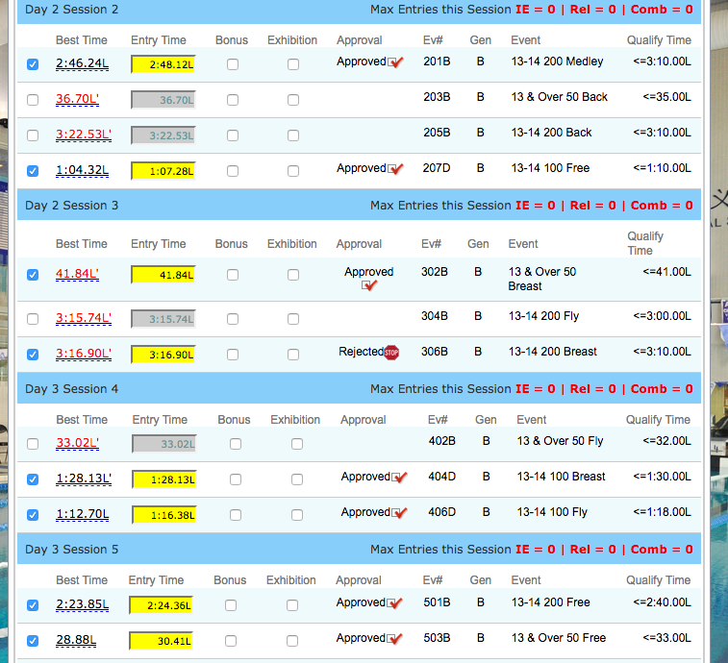
Signing Up For Meets
*Please ensure swimmers qualify

Slide 41
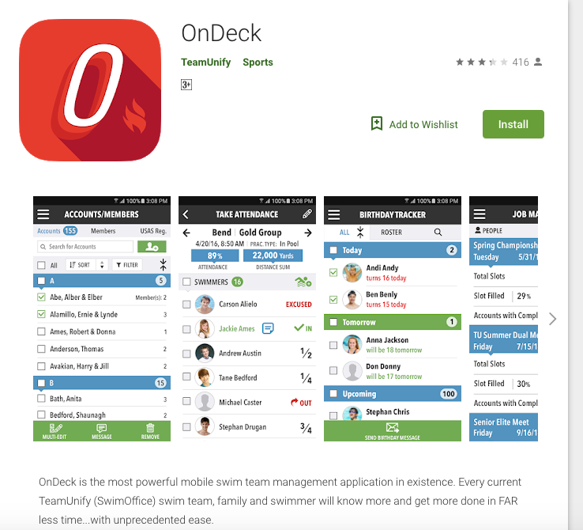
OnDeck App – Team Unify
On Deck Parent App. Code - RECZZIDSC

Slide 42
Reminders for swimmers at meets
Check in by finding your name on the meet check-in sheets.
No towels are provided at swim meets
No Food On Deck
Clean Up Pool Deck
Quiet at the start of races.
Listen to marshals when calling out names.
Exit out the sides, not over touch pads.
Listen to the volunteers for over the top or exiting the pool guidance.

Slide 43
Goals for the Academy this Year..
ISB DRAGON CORE SPORTING VALUES
COMMITMENT – RESPECT – FUN
Attendance – Child-safeguarding
IM Integration as per the LTAD ethos
Continue to grow and foster team spirit.
Dry-land Integration
TECH LANE as a tool for coaches and swimmers.
Maintenance of Average 80 % PB Tracking

Slide 44
How Can Families Help Foster Team Spirit?
Volunteering at Meets. Best seat in the house often! ☺ Your children love to see you involved and we become a closer swim family.
Set-up opportunities for swimmers to socialize and have fun outside pool practice.
Support personal goals but also aim to contribute to ISB team goals.
Help to reinforce International Best Fair Play Rules – One team only for competing.
Promoting coach / swimmer relationship building. Pre-race chats and feedback at meets.
Promote ISB first, and if you have to choose providers to help support ISB’s goals.
Help us to celebrate skill acquisition and technique improvements in combination with time improvements, rather than just on time drops and or placing alone.
Work in partnership with ISB to help your children reach their full potential.

Slide 45
Things for Swimmers to be mindful of….
Am I attending my minimum practices?
Am I on time to my practices?
Am I developing a relationship with my coach to reach my personal and team goals?
Am I a good sport, win or lose?
Do I meet with my coach before and after swimming in races?
Am I contributing to team goals as well as working on individual ones?

Slide 46
We look forward to a wonderful year.
Any Questions?

